Slide 1
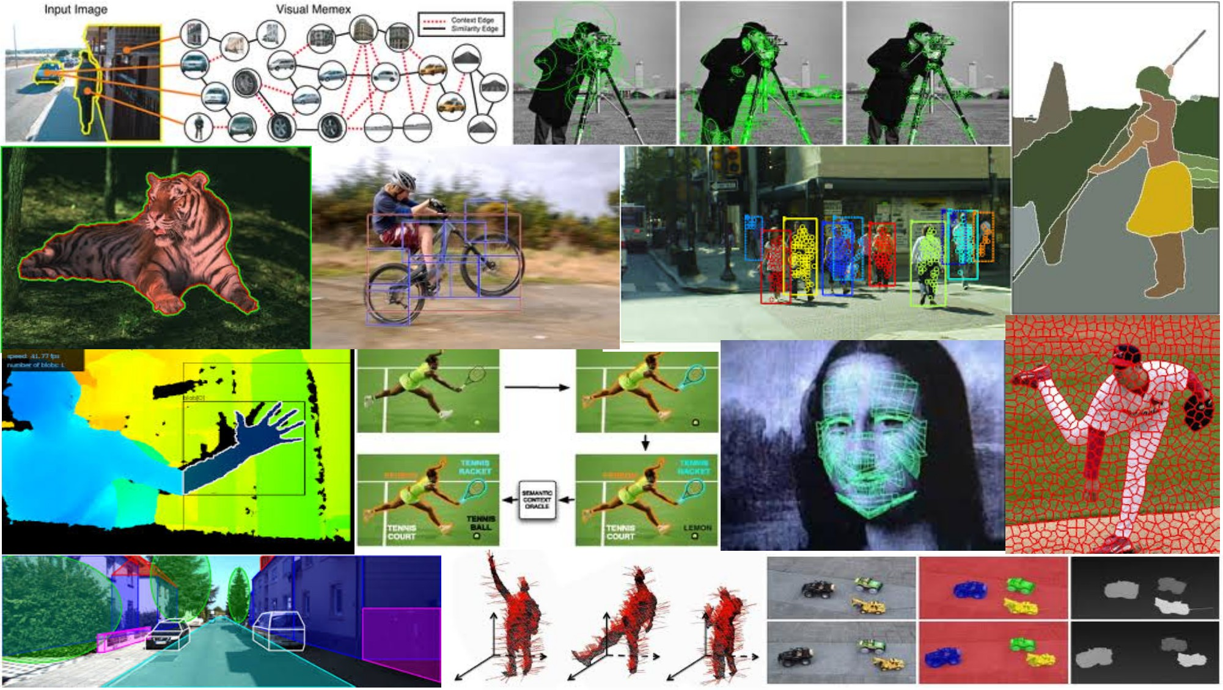
Local features: detection and description May 10th, 2018
Yong Jae Lee
UC Davis

Slide 2
Last time
Detecting corner-like points in an image

Slide 3
Today
Local invariant features
Detection of interest points
(Harris corner detection)
Scale invariant blob detection: LoG
Description of local patches
SIFT: Histograms of oriented gradients

Slide 4

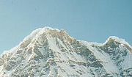
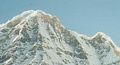
Local features: main components
Detection: Identify the interest points
Description: Extract vector feature descriptor surrounding each interest point.
Matching: Determine correspondence between descriptors in two views
Kristen Grauman

Slide 5
Goal: interest operator repeatability
We want to detect (at least some of) the same points in both images.
Yet we have to be able to run the detection procedure independently per image.
No chance to find true matches!
Kristen Grauman
Notes:
5

Slide 6
Goal: descriptor distinctiveness
We want to be able to reliably determine which point goes with which.
Must provide some invariance to geometric and photometric differences between the two views.
?
Kristen Grauman

Slide 7
Local features: main components
Detection: Identify the interest points
Description:Extract vector feature descriptor surrounding each interest point.
Matching: Determine correspondence between descriptors in two views
Kristen Grauman
Notes:
second moment matrix

Slide 8
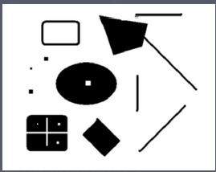
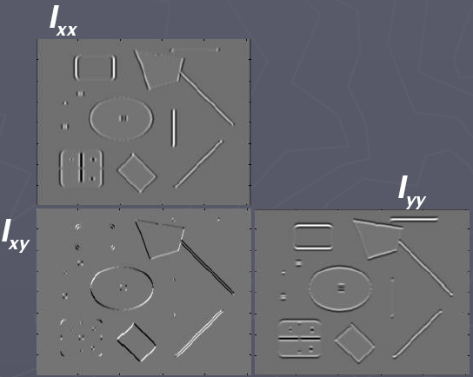
Recall: Corners as distinctive interest points
2 x 2 matrix of image derivatives (averaged in neighborhood of a point).
Notation:
Kristen Grauman

Slide 9

Recall: Corners as distinctive interest points
Since M is symmetric, we have
(Eigenvalue decomposition)
The eigenvalues of M reveal the amount of intensity change in the two principal orthogonal gradient directions in the window.

Slide 10
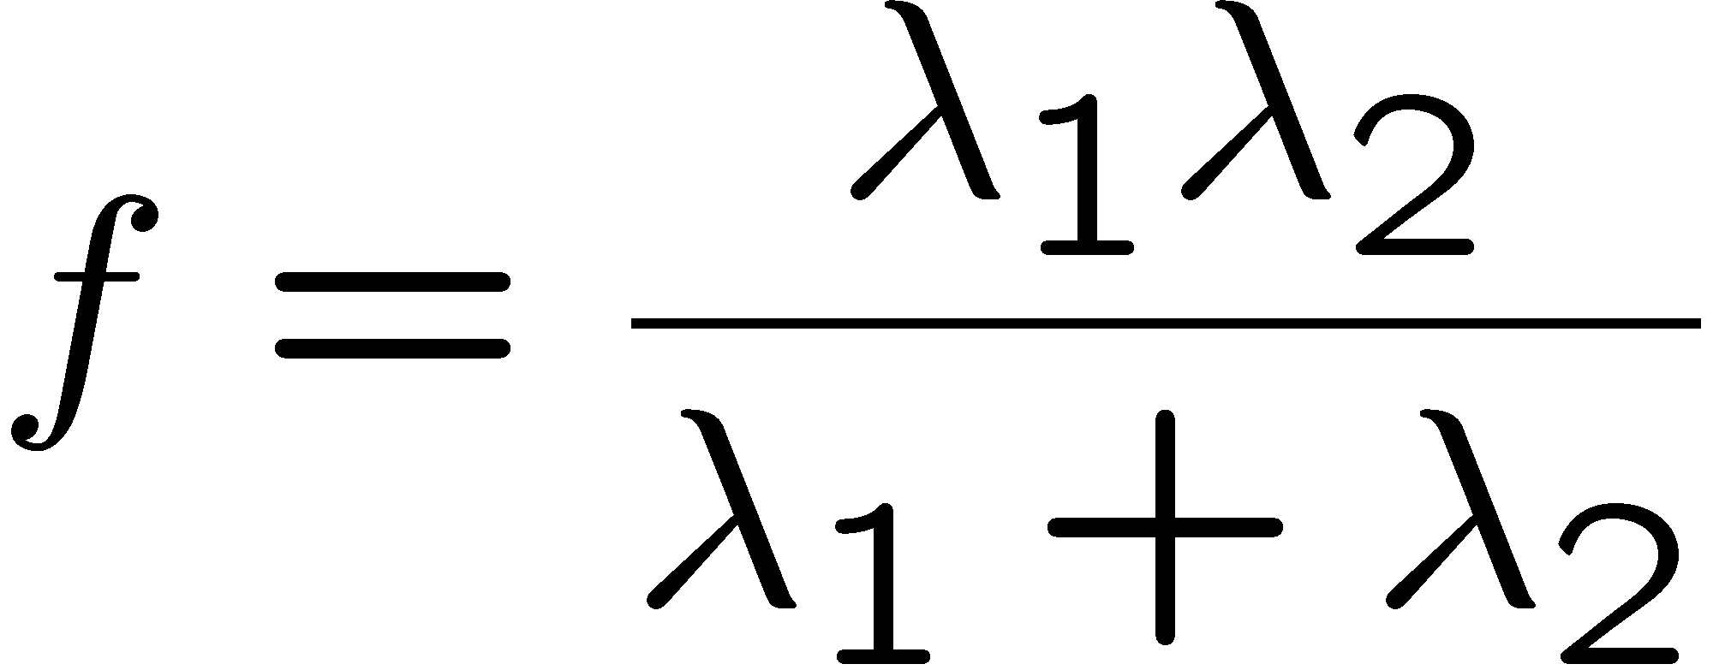
Recall: Corners as distinctive interest points
“edge”:
“corner”:
“flat” region
λ₁ >> λ₂
λ₁ and λ₂ are large, λ₁ ~ λ₂;
λ₁ and λ₂ are small;
λ₂ >> λ₁
One way to score the cornerness:

Slide 11
Harris corner detector
Compute M matrix for image window surrounding each pixel to get its cornerness score.
Find points with large corner response (f > threshold)
Take the points of local maxima, i.e., perform non-maximum suppression
Kristen Grauman
Notes:
11

Slide 12

Harris Detector: Steps

Slide 13

Harris Detector: Steps
Compute corner response f

Slide 14

Harris Detector: Steps
Find points with large corner response: f > threshold

Slide 15
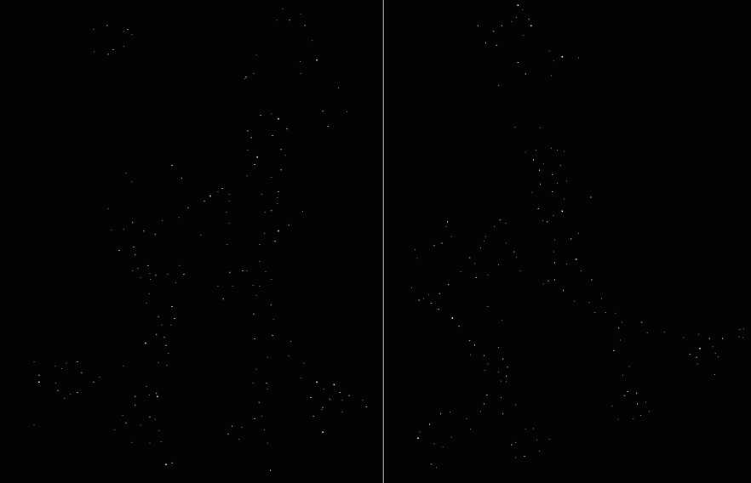
Harris Detector: Steps
Take only the points of local maxima of f

Slide 16

Harris Detector: Steps

Slide 17
Properties of the Harris corner detector
Rotation invariant?
Yes

Slide 18
Properties of the Harris corner detector
Rotation invariant?
Translation invariant?
Yes
Yes

Slide 19
Properties of the Harris corner detector
Rotation invariant?
Translation invariant?
Scale invariant?
Yes
Yes
No
All points will be classified as edges
Corner !

Slide 20
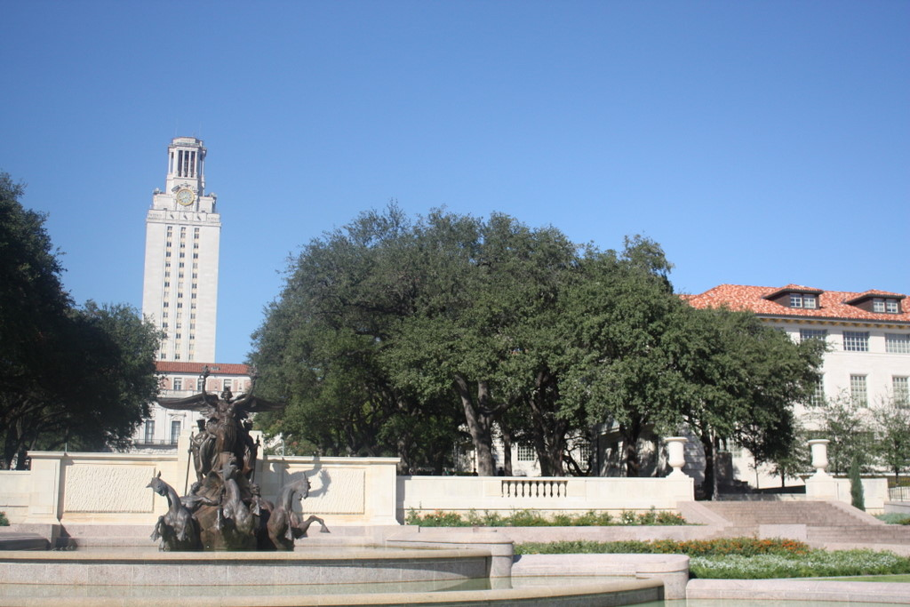
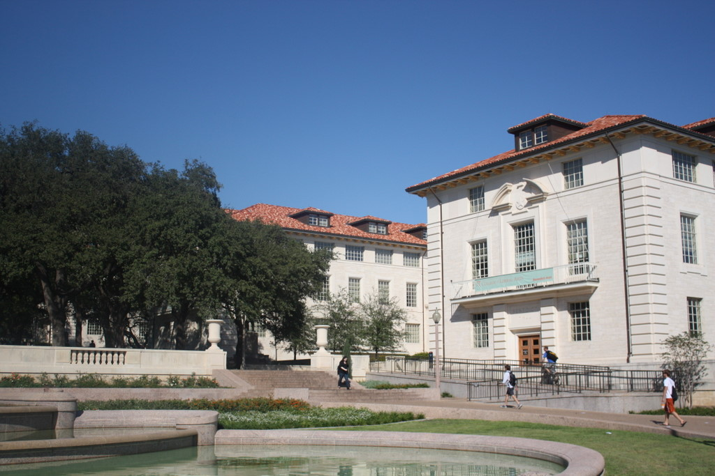
Scale invariant interest points
How can we independently select interest points in each image, such that the detections are repeatable across different scales?
Kristen Grauman

Slide 21
Automatic scale selection
Intuition:
Find scale that gives local maxima of some function f in both position and scale.
f
f
Image 1
Image 2
s₁
region size
s₂
region size
Slide credit: Kristen Grauman

Slide 22
What can be the “signature” function?
Kristen Grauman

Slide 23
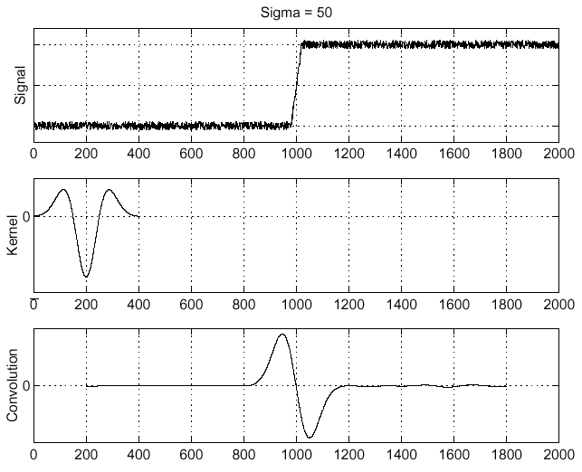
Recall: Edge detection
f
Edge
Second derivative of Gaussian (Laplacian)
Edge = zero crossing of second derivative
Source: S. Seitz

Slide 24
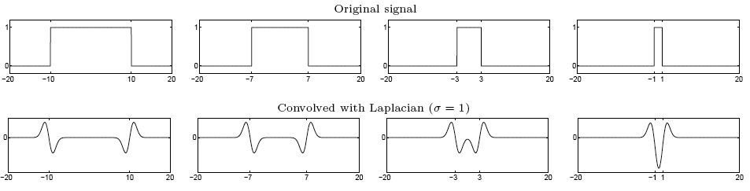
From edges to blobs
Edge = ripple
Blob = superposition of two ripples
maximum
Spatial selection: the magnitude of the Laplacian response will achieve a maximum at the center of the blob, provided the scale of the Laplacian is “matched” to the scale of the blob
Slide credit: Lana Lazebnik
Notes:
When two waves meet they overlap and interact.

Slide 25
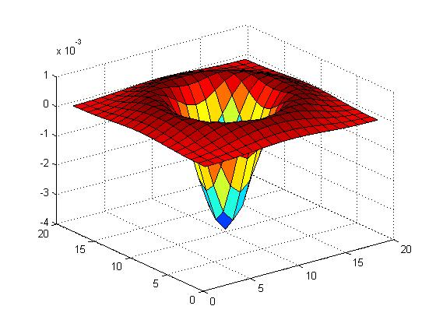

Blob detection in 2D
Laplacian of Gaussian: Circularly symmetric operator for blob detection in 2D

Slide 26
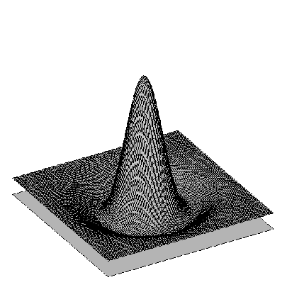

Blob detection in 2D: scale selection
Laplacian-of-Gaussian = “blob” detector
filter scales
img2
Bastian Leibe
img1
img3

Slide 27
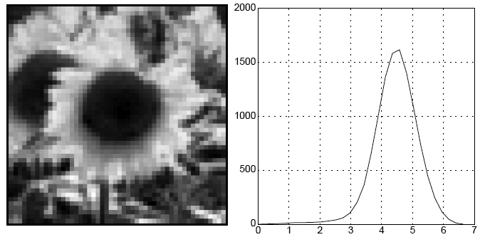
Blob detection in 2D
We define the characteristic scale as the scale that produces peak of Laplacian response
characteristic scale
Slide credit: Lana Lazebnik

Slide 28
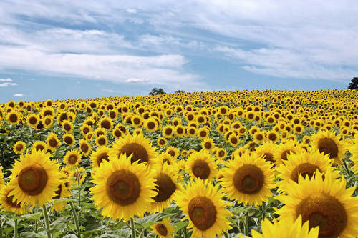
Example
Kristen Grauman

Slide 29
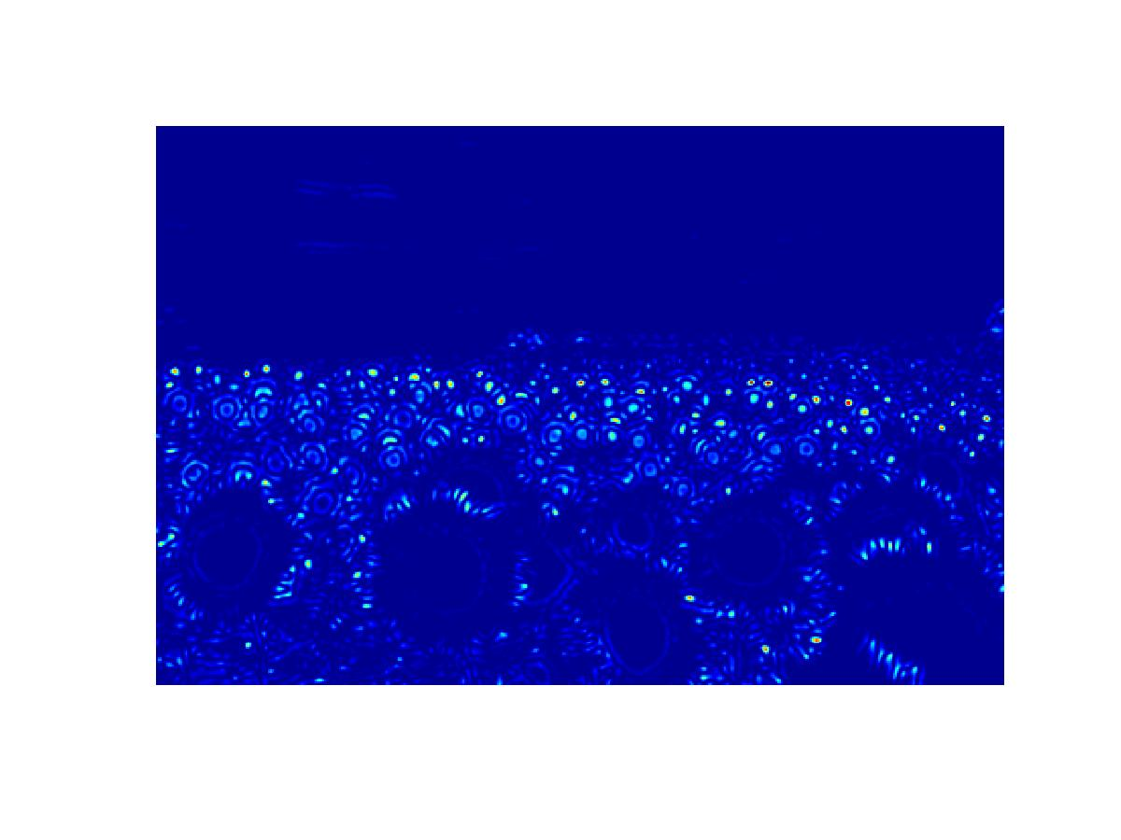
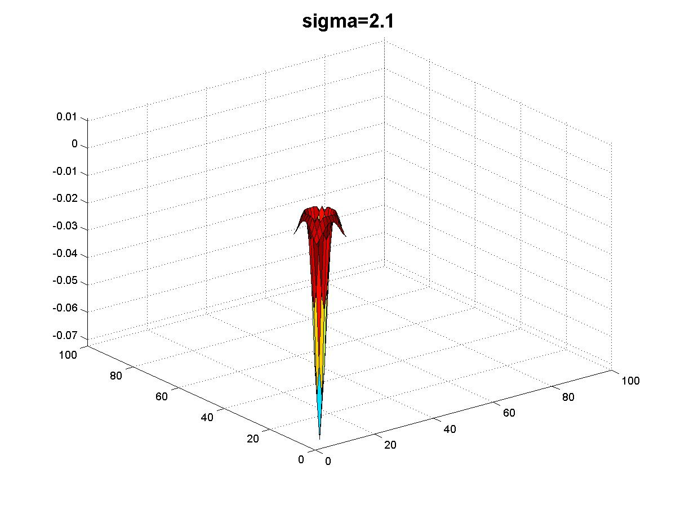
Kristen Grauman

Slide 30
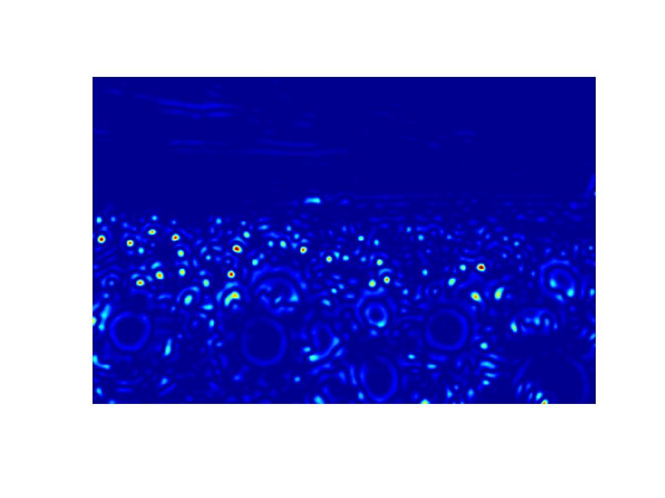
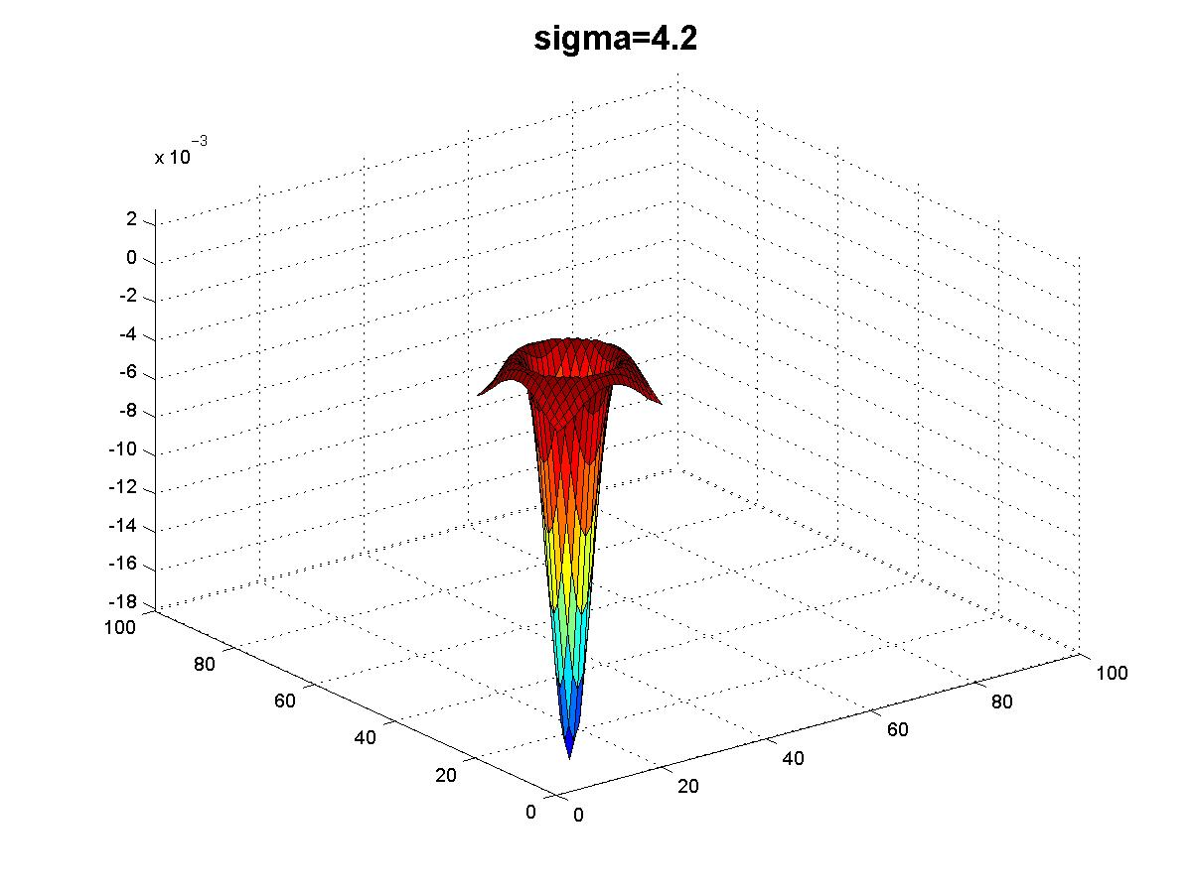
Kristen Grauman

Slide 31
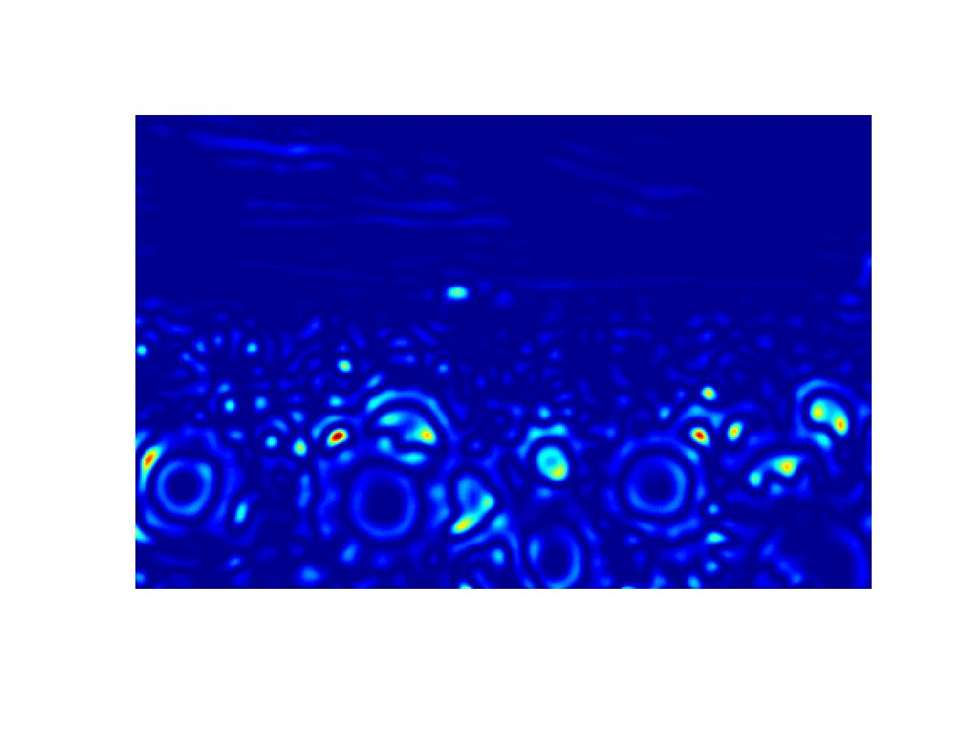
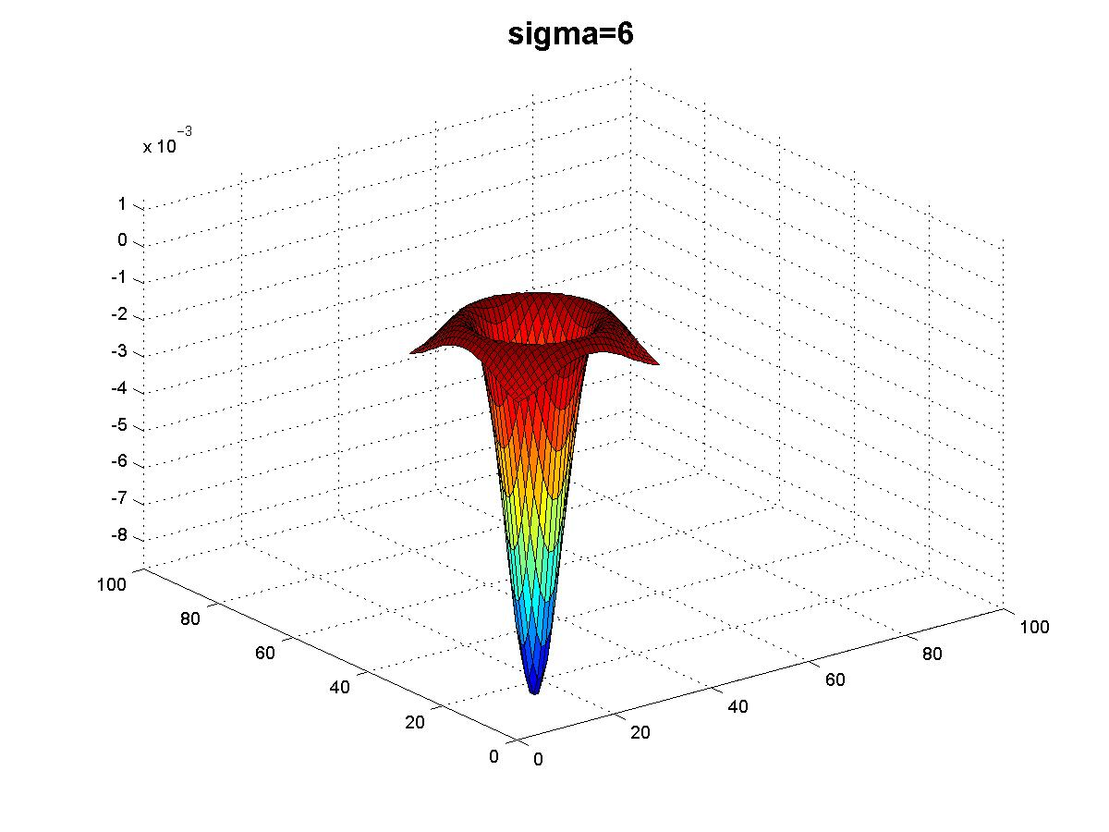
Kristen Grauman

Slide 32
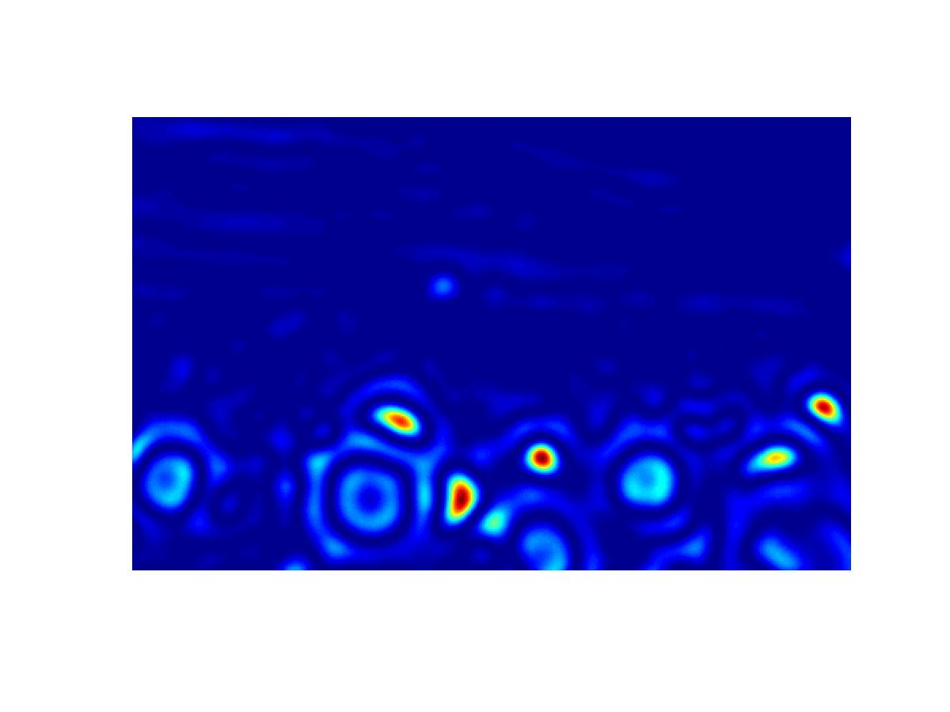
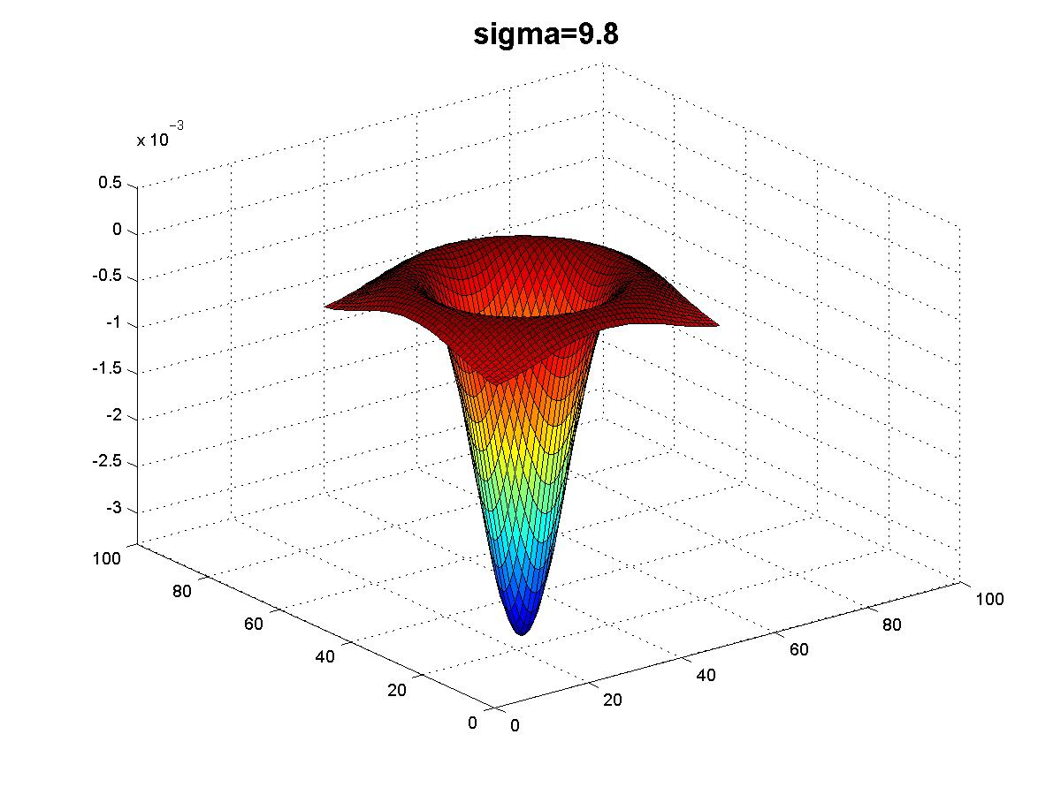
Kristen Grauman

Slide 33
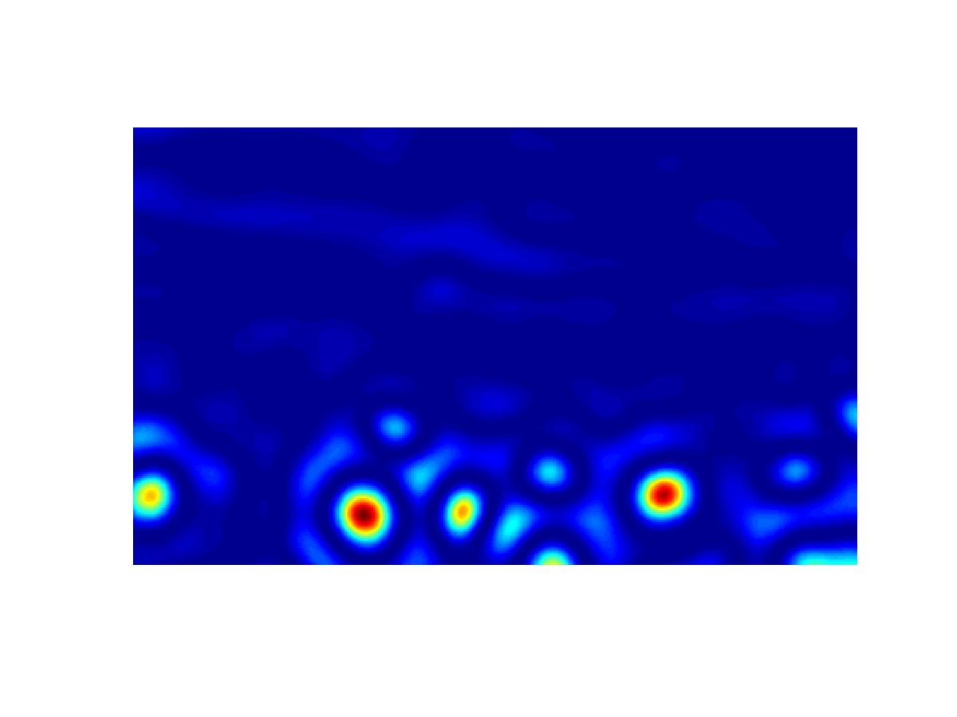
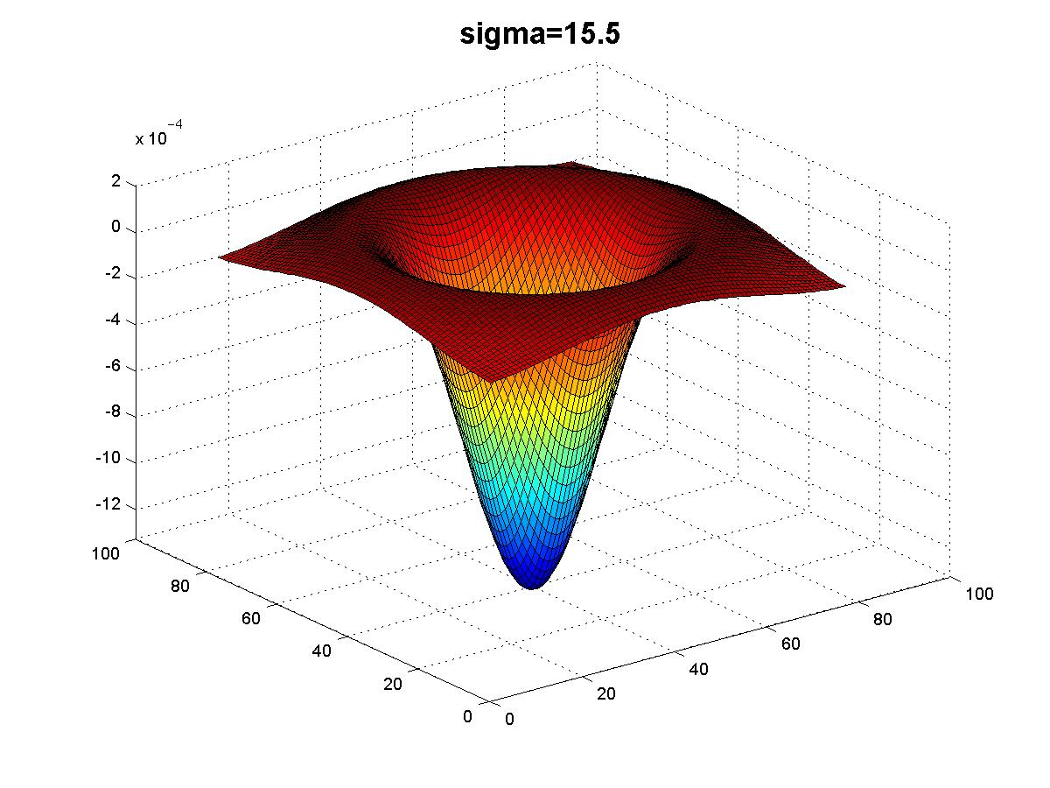
Kristen Grauman

Slide 34
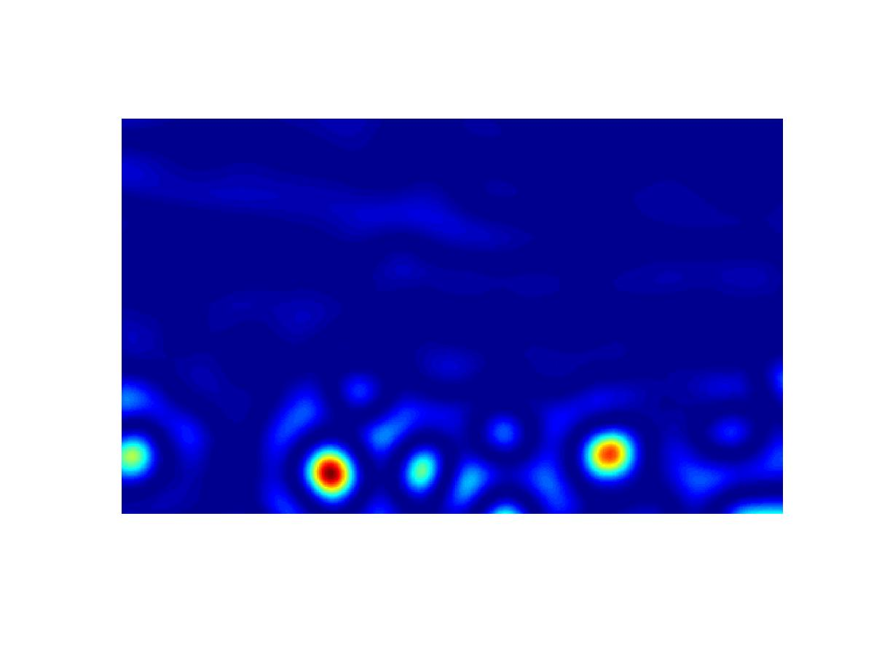
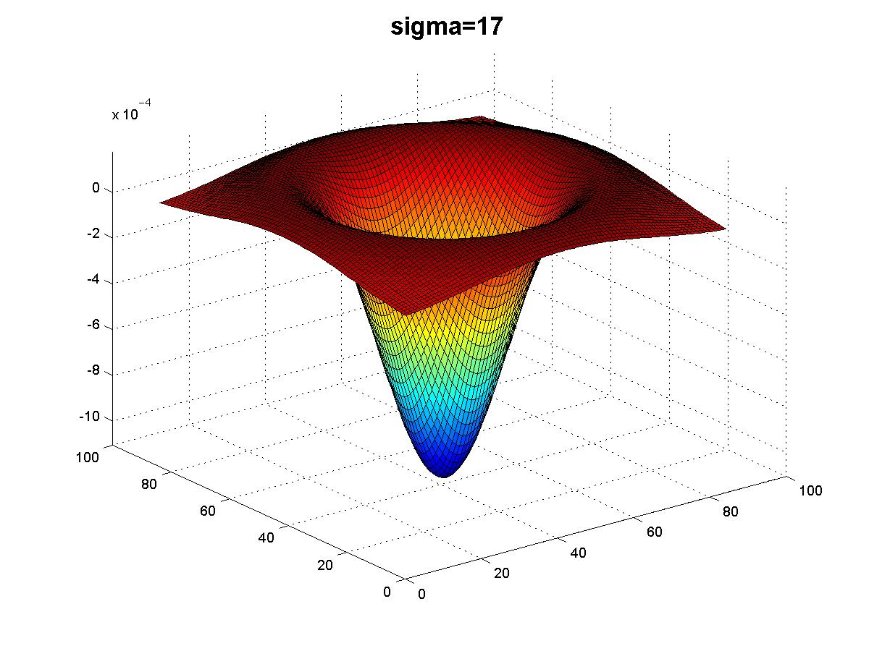
Kristen Grauman

Slide 35
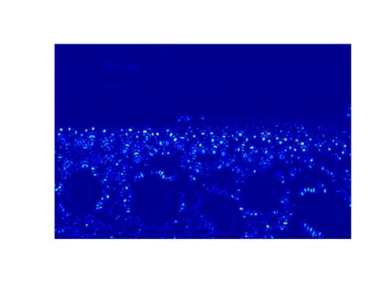
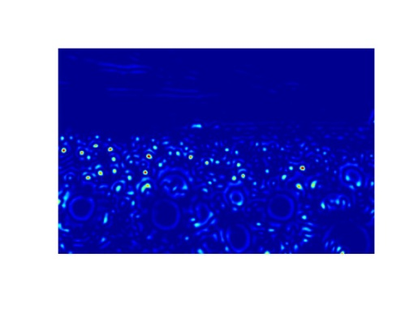
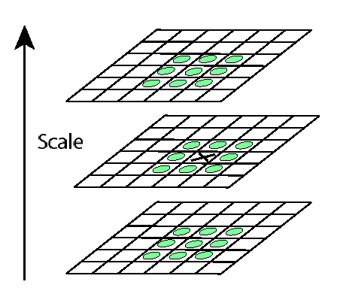
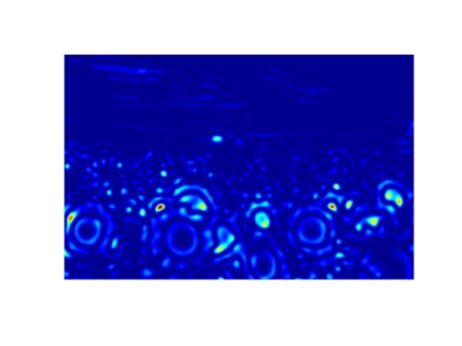
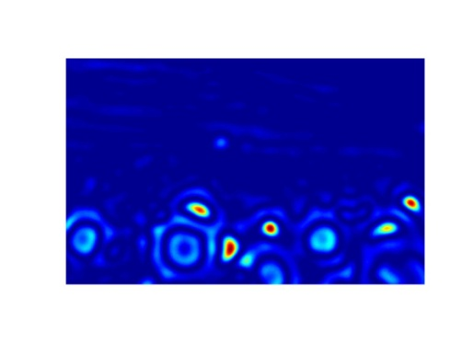

Scale invariant interest points
Interest points are local maxima in both position and scale.
σ5
σ4
scale
σ3
σ2
⇒ List of (x, y, σ)
σ1
Squared filter response maps
Kristen Grauman

Slide 36
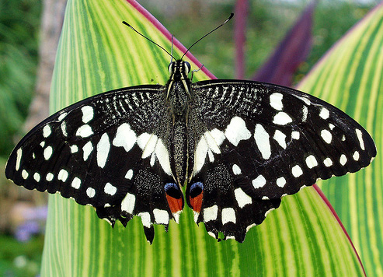
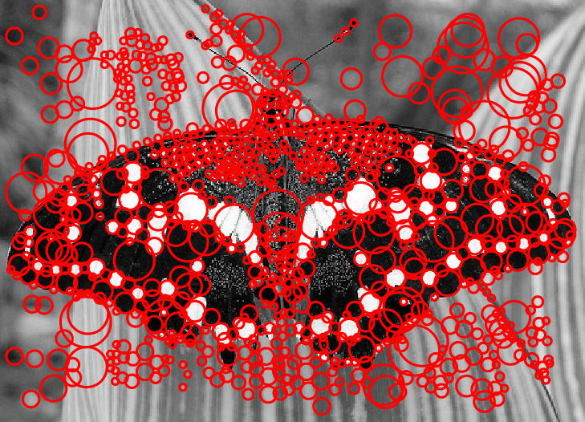
Scale-space blob detector: Example
Image credit: Lana Lazebnik

Slide 37
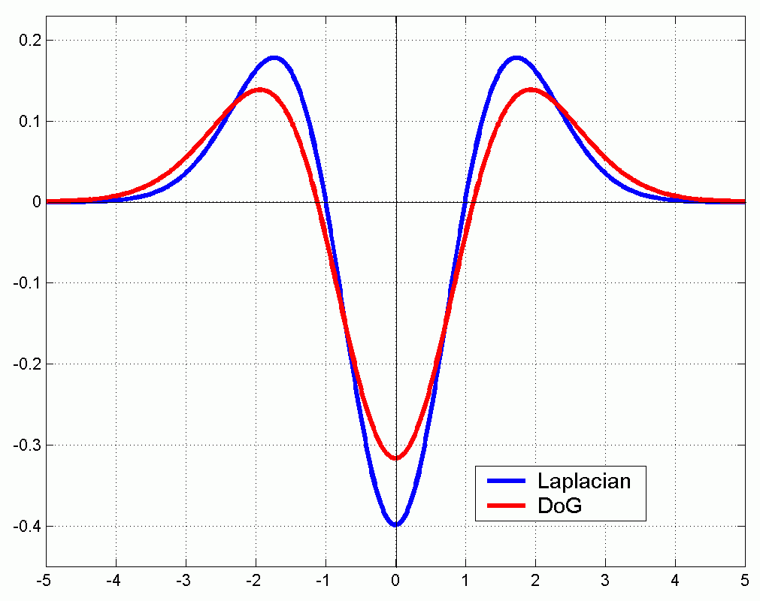
Technical detail
We can approximate the Laplacian with a difference of Gaussians; more efficient to implement.
(Laplacian)
(Difference of Gaussians)
Slide credit: Kristen Grauman
Notes:
k~1.6

Slide 38
Local features: main components
Detection: Identify the interest points
Description: Extract vector feature descriptor surrounding each interest point.
Matching: Determine correspondence between descriptors in two views
Slide credit: Kristen Grauman

Slide 39




Geometric transformations
e.g. scale, translation, rotation
Slide credit: Kristen Grauman

Slide 40
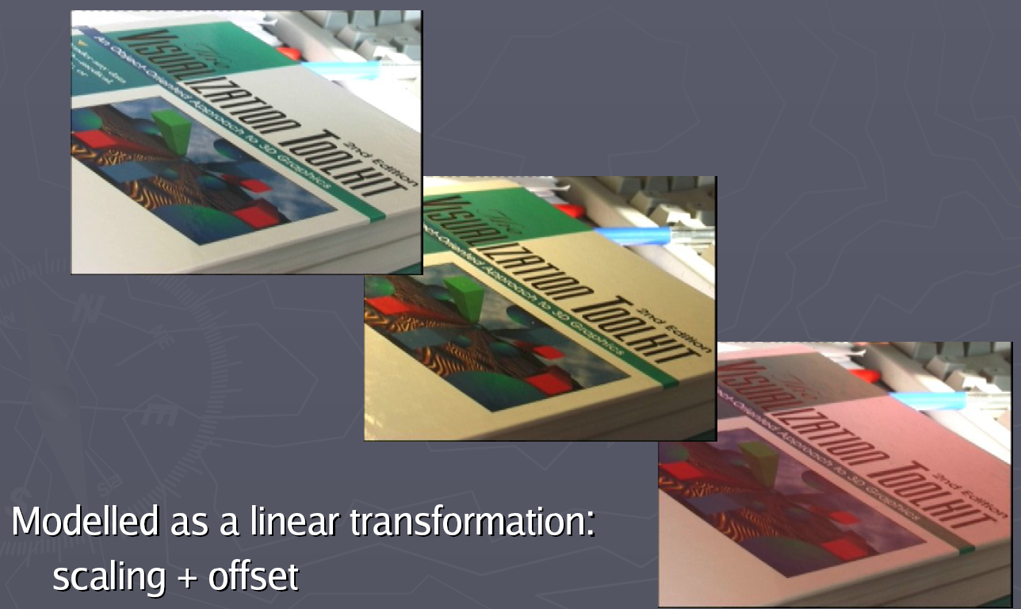
Photometric transformations
Figure from T. Tuytelaars ECCV 2006 tutorial

Slide 41
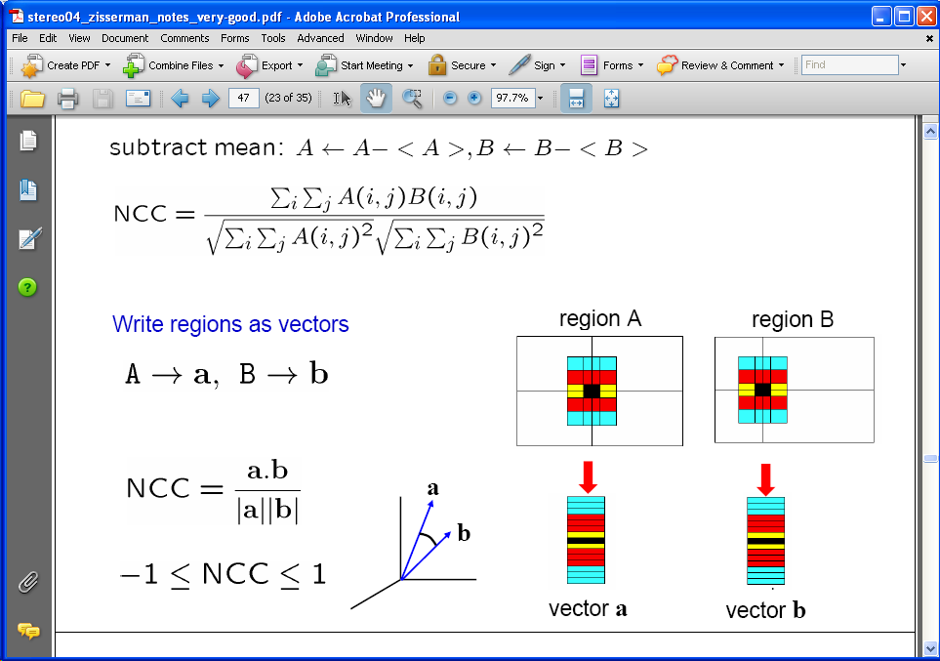
Raw patches as local descriptors
The simplest way to describe the neighborhood around an interest point is to write down the list of intensities to form a feature vector.
But this is very sensitive to even small shifts, rotations.
Slide credit: Kristen Grauman

Slide 42

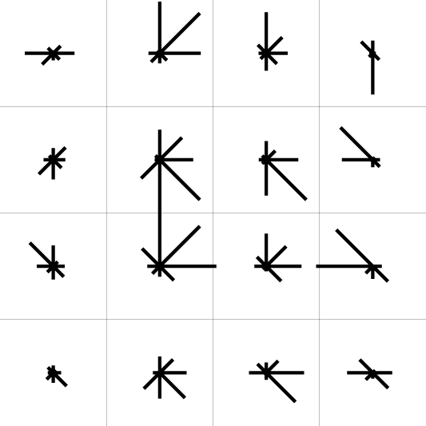
SIFT descriptor [Lowe 2004]
Use histograms to bin pixels within sub-patches according to their orientation.
0
2
π
Why subpatches?
Why does SIFT have some illumination invariance?
Slide credit: Kristen Grauman
Notes:
Preserve spatial structure
Gradients

Slide 43
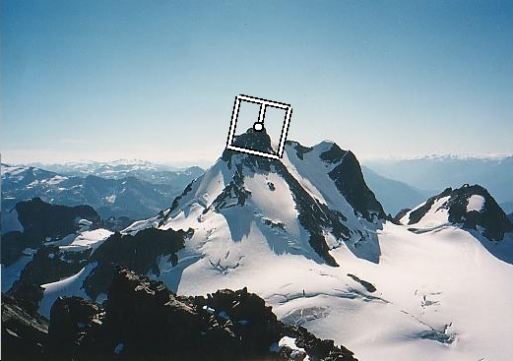
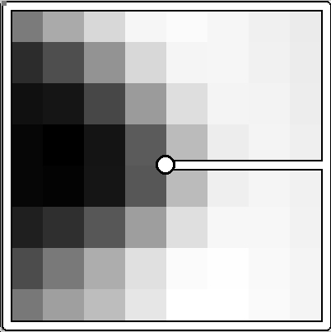
Making descriptor rotation invariant
CSE 576: Computer Vision
Rotate patch according to its dominant gradient orientation
This puts the patches into a canonical orientation.
Image from Matthew Brown

Slide 44
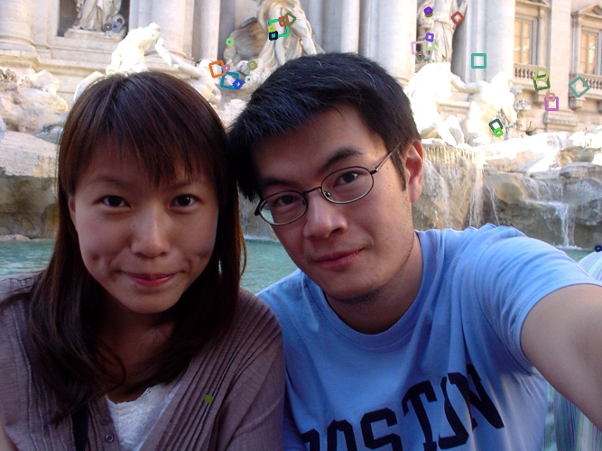
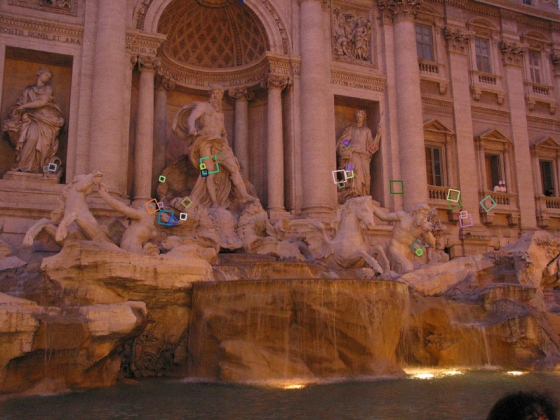
SIFT descriptor [Lowe 2004]
Extraordinarily robust matching technique
Can handle changes in viewpoint
Up to about 60 degree out of plane rotation
Can handle significant changes in illumination
Sometimes even day vs. night (below)
Fast and efficient—can run in real time
Lots of code available
http://people.csail.mit.edu/albert/ladypack/wiki/index.php/Known_implementations_of_SIFT
44
Steve Seitz

Slide 45
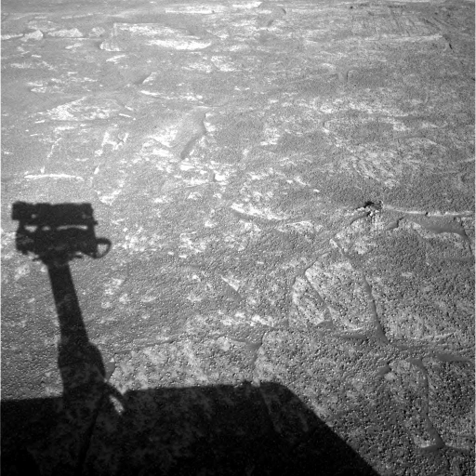
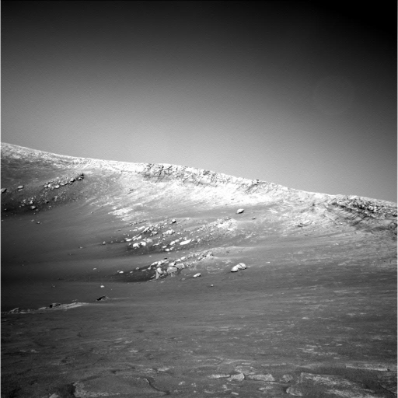
Example
NASA Mars Rover images

Slide 46
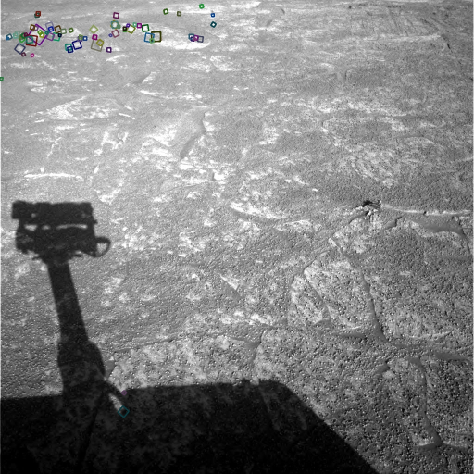
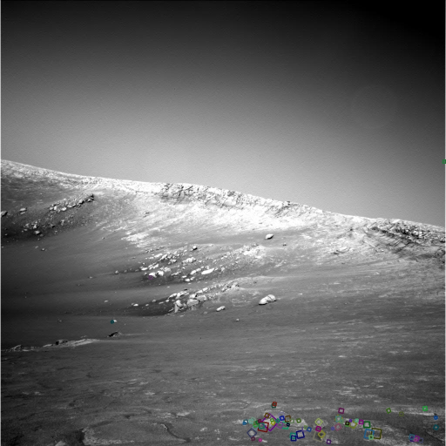
Example
NASA Mars Rover images
with SIFT feature matches Figure by Noah Snavely

Slide 47
SIFT descriptor properties
Invariant to
Scale
Rotation
Partially invariant to
Illumination changes
Camera viewpoint
Occlusion, clutter

Slide 48
Local features: main components
Detection: Identify the interest points
Description:Extract vector feature descriptor surrounding each interest point.
Matching: Determine correspondence between descriptors in two views
Slide credit: Kristen Grauman

Slide 49
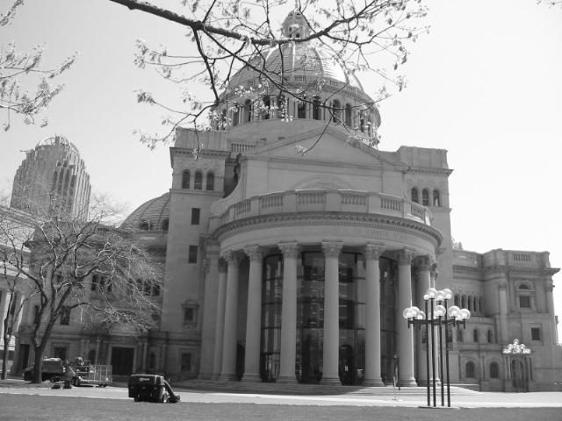
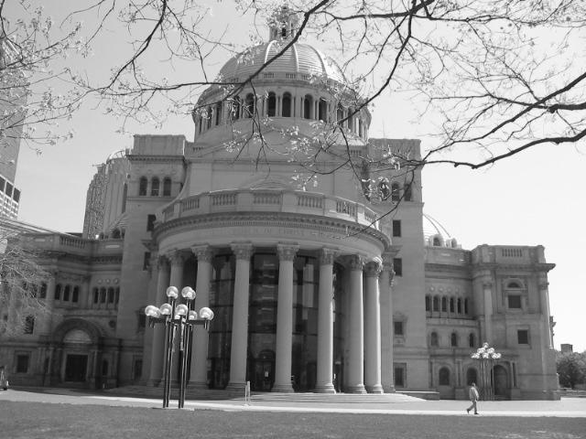
Matching local features
Kristen Grauman

Slide 50
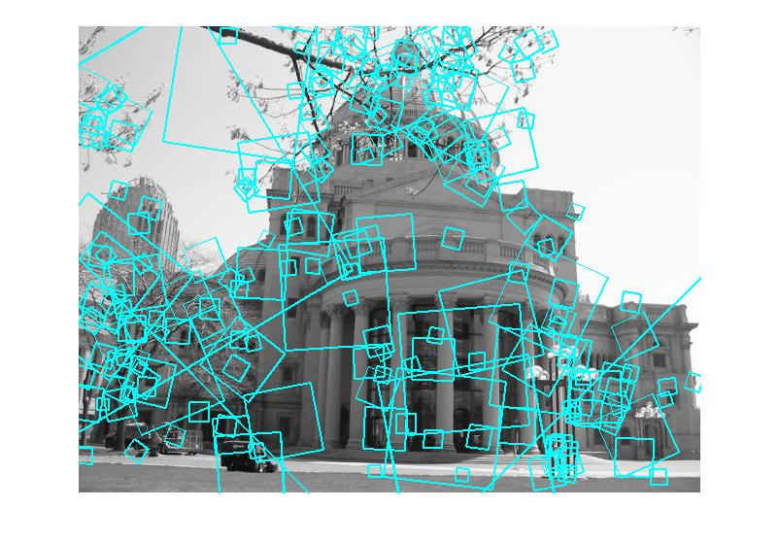
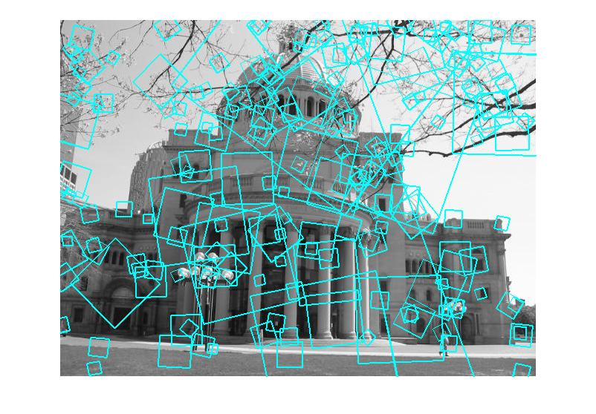
Matching local features
?
Image 1
Image 2
To generate candidate matches, find patches that have the most similar appearance (e.g., lowest SSD)
Simplest approach: compare them all, take the closest (or closest k, or within a thresholded distance)
Kristen Grauman

Slide 51
Ambiguous matches
?
?
?
?
Image 1
Image 2
To add robustness to matching, can consider ratio: distance to best match / distance to second best match
If low, first match looks good.
If high, could be ambiguous match.
Kristen Grauman

Slide 52

Matching SIFT Descriptors
Nearest neighbor (Euclidean distance)
Threshold ratio of nearest to 2nd nearest descriptor
Lowe IJCV 2004

Slide 53


Recap: robust feature-based alignment
Source: L. Lazebnik

Slide 54

Recap: robust feature-based alignment
Extract features
Source: L. Lazebnik

Slide 55
Recap: robust feature-based alignment
Extract features
Compute putative matches
Source: L. Lazebnik

Slide 56
Recap: robust feature-based alignment
Extract features
Compute putative matches
Loop:
Hypothesize transformation T (small group of putative matches that are related by T)
Source: L. Lazebnik

Slide 57
Recap: robust feature-based alignment
Extract features
Compute putative matches
Loop:
Hypothesize transformation T (small group of putative matches that are related by T)
Verify transformation (search for other matches consistent with T)
Source: L. Lazebnik

Slide 58

Recap: robust feature-based alignment
Extract features
Compute putative matches
Loop:
Hypothesize transformation T (small group of putative matches that are related by T)
Verify transformation (search for other matches consistent with T)
Source: L. Lazebnik

Slide 59
Applications of local invariant features
Wide baseline stereo
Motion tracking
Panoramas
3D reconstruction
Recognition (better for instance matching)
…

Slide 60



Automatic mosaicing
http://www.cs.ubc.ca/~mbrown/autostitch/autostitch.html
Slide credit: Kristen Grauman
Notes:
AutoStitch works from unordered collections of images, automatically finding matches between images using SIFT. It then robustly aligns all images and uses advanced blending algorithms to form seamless panoramas.

Slide 61

Wide baseline stereo
[Image from T. Tuytelaars ECCV 2006 tutorial]

Slide 62




Recognition of specific objects, scenes
Schmid and Mohr 1997
Sivic and Zisserman, 2003
Rothganger et al. 2003
Lowe 2002
Kristen Grauman

Slide 63
Summary
Interest point detection
Harris corner detector
Laplacian of Gaussian, automatic scale selection
Invariant descriptors
Rotation according to dominant gradient direction
Histograms for robustness to small shifts and translations (SIFT descriptor)

Slide 64
Questions?

